Slide 1

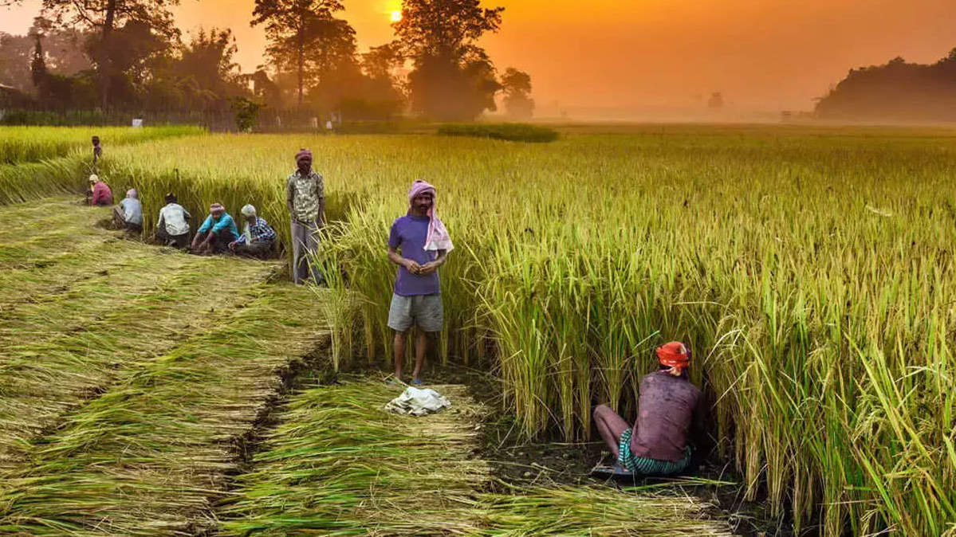
INDIAN CROP ANALYSIS
-SOHAN GURAV

Slide 2
Agenda
Introduction
Crops cultivated in India
Major crops cultivated in India by :
Area
Year
Crops by Yield
Fruits & Vegetable Cultivation by States & Year
Comparison between India & foreign countries
Summary

Slide 3
introduction
Agriculture is an important sector of Indian economy as it contributes about 17% to the total GDP and provides employment to over 60% of the population.
Indian agriculture has registered impressive growth over last few decades.
The foodgrain production has increased from 51 million tonnes (MT) in 1950-51 to 250 MT during 2011-12 highest ever since independence.
The production of oilseeds (nine-major oilseed) has also increased from 5 MT to 28 MT during the same period. The rapid growth has helped Indian agriculture mark its presence at global level.
India stands among top three in terms of production of various agricultural commodities like paddy, wheat, pulses, groundnut, rapeseeds, fruits, vegetables, sugarcane, tea, jute, cotton, tobacco leaves, etc.
However, on marketing front, Indian agriculture is still facing the problems such as low degree of market integration and connectivity, accessibility of reliable and timely information required by farmers on various issues in agriculture.
Huge postharvest losses, multiple market intermediaries; higher transaction cost, lack of awareness and several other socio-economic factors are some of the acute problems being faced by the Indian agriculture.

Slide 4
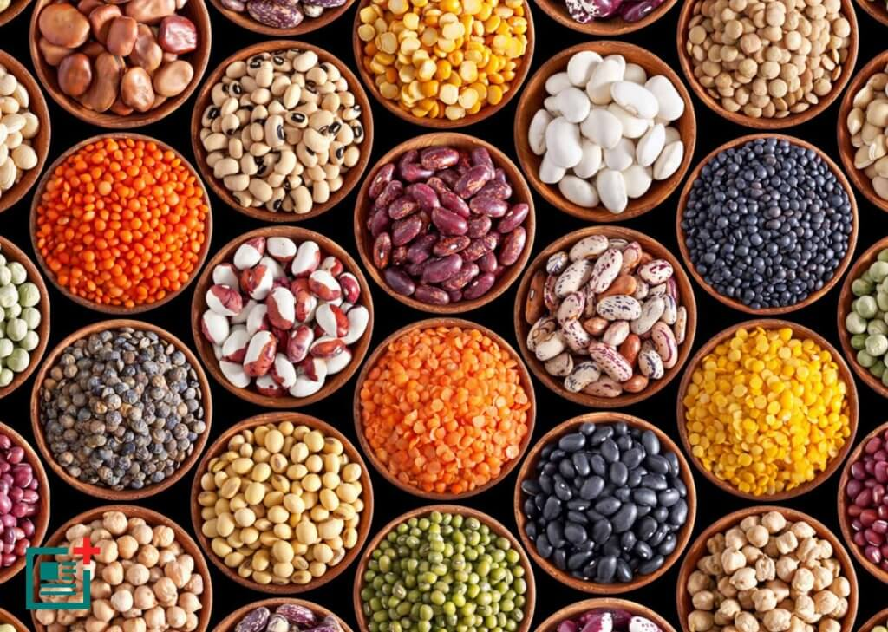
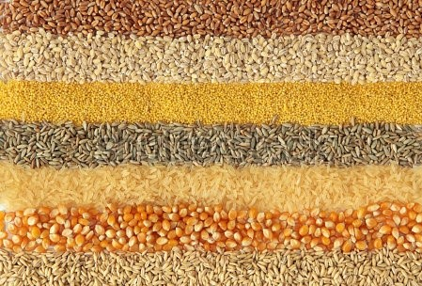
Crops cultivated in India
Barley
Finger Millet
Kharif Sorghum
Maize
Pearl Millet
Rabi Sorghum
Rice
Sorghum
Wheat
Cotton
Castor
Groundnut
Linseed
Rapeseed and Mustard
Safflower
Sesamum
Soyabean
Sunflower
Chickpea
Minor Pulse
Pigeonpea
Sugarcane

Slide 5
MAJOR CROPS CULTIVATED IN INDIA
From the graph, it is clear that India has always been a major producer of Rice, Wheat, Sugarcane, Cotton etc.
West Bengal is the largest producer of rice, which is about 445,598 (1000 tons).
While, Uttar Pradesh has been the largest producer of Wheat and Sugarcane, about 970,210 (1000 tons) and 506,242 (1000 tons) respectively.

Slide 6
CROPS CULTIVATED IN INDIA BY AREA
Average area cultivated in India in the year 1966 was 546,000 ha, while it increased to 661,000 ha during the year 2013, which then dropped to 578,000 ha in 2017.
There several reasons to this, such as more and more people are shifting to urban areas with the increase in industrial sector.
Also, since people are moving to urban areas less people are farming. So, now there more people who need food, but less people to grow these crop foods.
From, the graph it can be seen that Maharashtra is the largest cultivator, but it is not the largest producer.
One factor affecting the production can be water scarcity that people of Maharashtra face, especially in the rural areas.

Slide 7
Crop cultivation between 1966-2017
Crop production in the year 1966 was 97060 (1000 tons) and in the year 2017 it was 389,963 (1000 tons).
The crop production since then has always shown a positive trend.
India has seen an increase of 300% in crop production between 1966 - 2017
Several factors are responsible for this, like the Green Revolution which began in the 1960s, during which agriculture in India was converted into a modern industrial system by adoption of High-yielding seeds, mechanized farm tools and etc.

Slide 8
Crops By yield
The highest yielding crop in India is Sugarcane, Wheat, Rice & Maize.
Uttar Pradesh is the largest producer of Sugarcane with a total yield of 11.2 Million kg per ha, followed by Maharashtra and Karnataka.
The factors contributing to the increase in yield of crops are:
The “HYV seeds” [ High Yielding Variety Seeds] which were introduced in the 1960s because of the green revolution.
Mechanized tools
Irrigation facilities
Fertilizers
Pesticides etc.

Slide 9
Fruits and vegetable cultivation by states & Year
Orissa is the largest cultivator of fruits and vegetables while Andhra Pradesh is the largest cultivator of fruits followed by Kerala.
Over the years, the cultivation area for fruits and vegetables has also increased significantly.
Proper irrigation, use of fertilizers and pesticides have contributed greatly towards this growth.

Slide 10
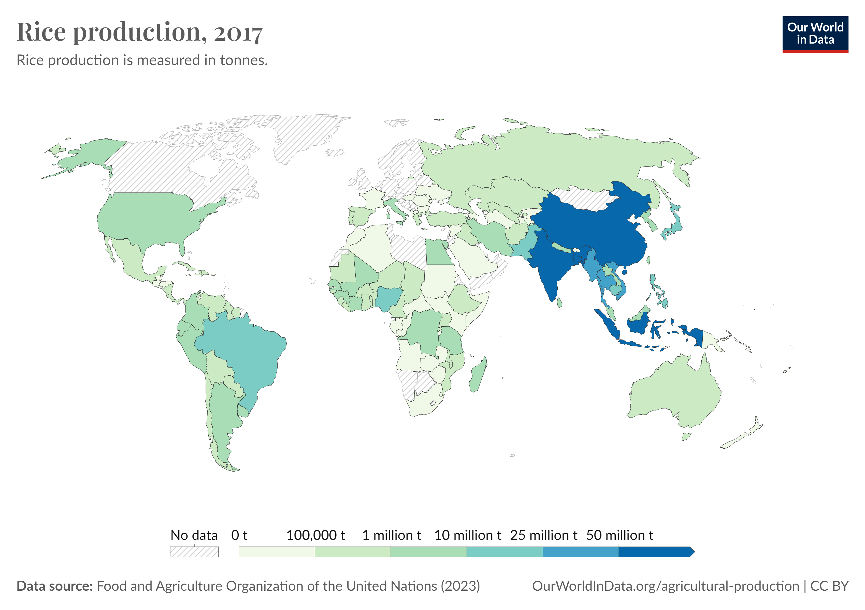
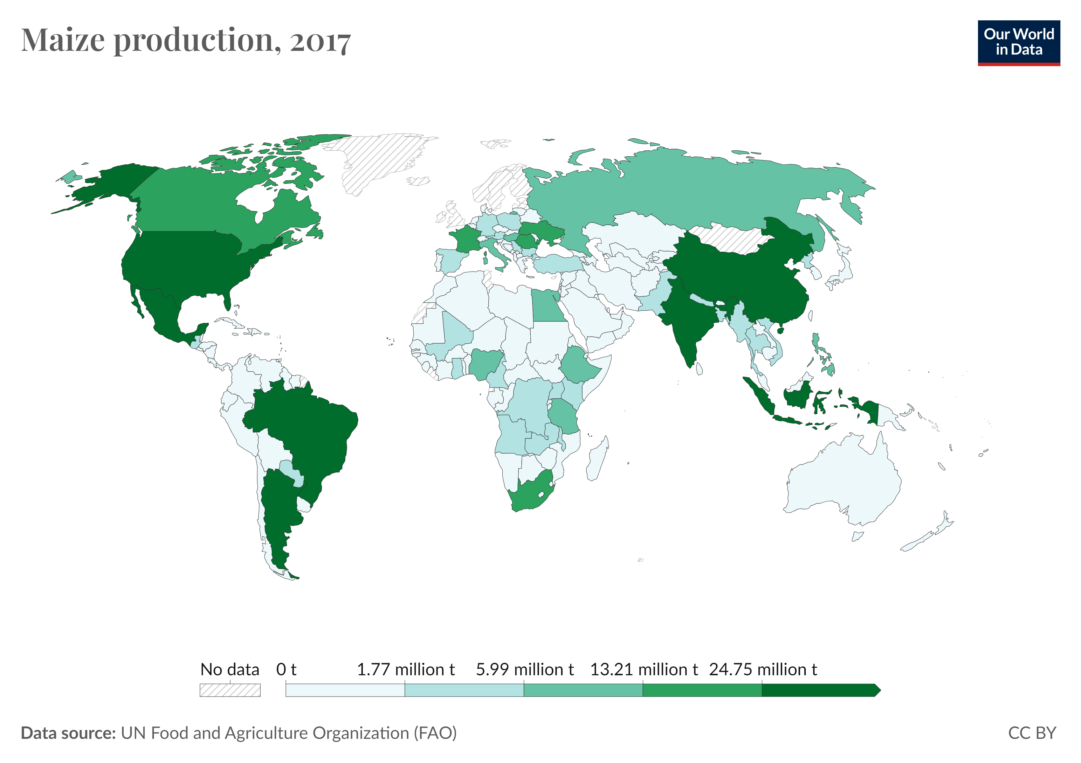
Comparison between India and foreign countries
From the map we can see that India and China are the largest producer of Rice, while the largest producer of Maize include countries like India, China, America and some parts of South America.

Slide 11
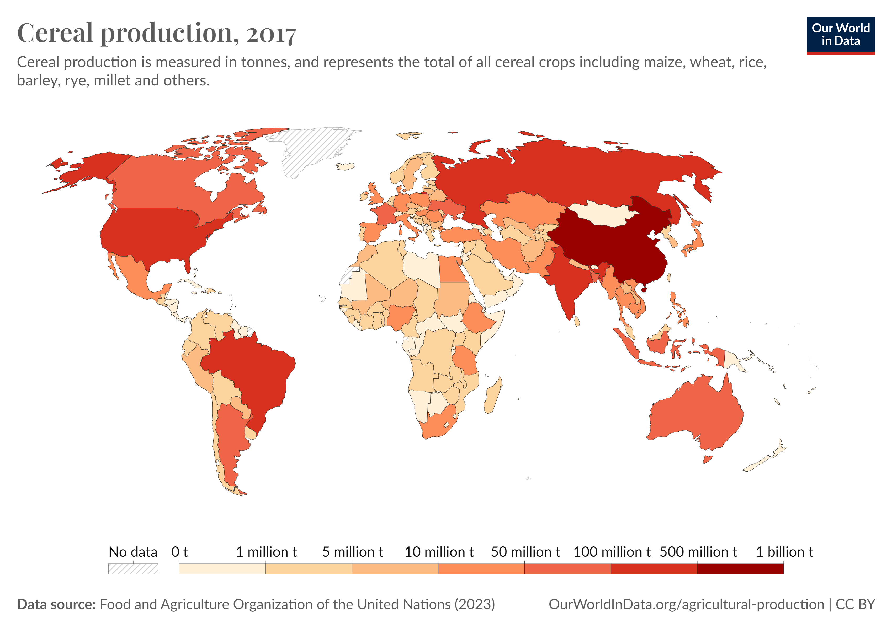
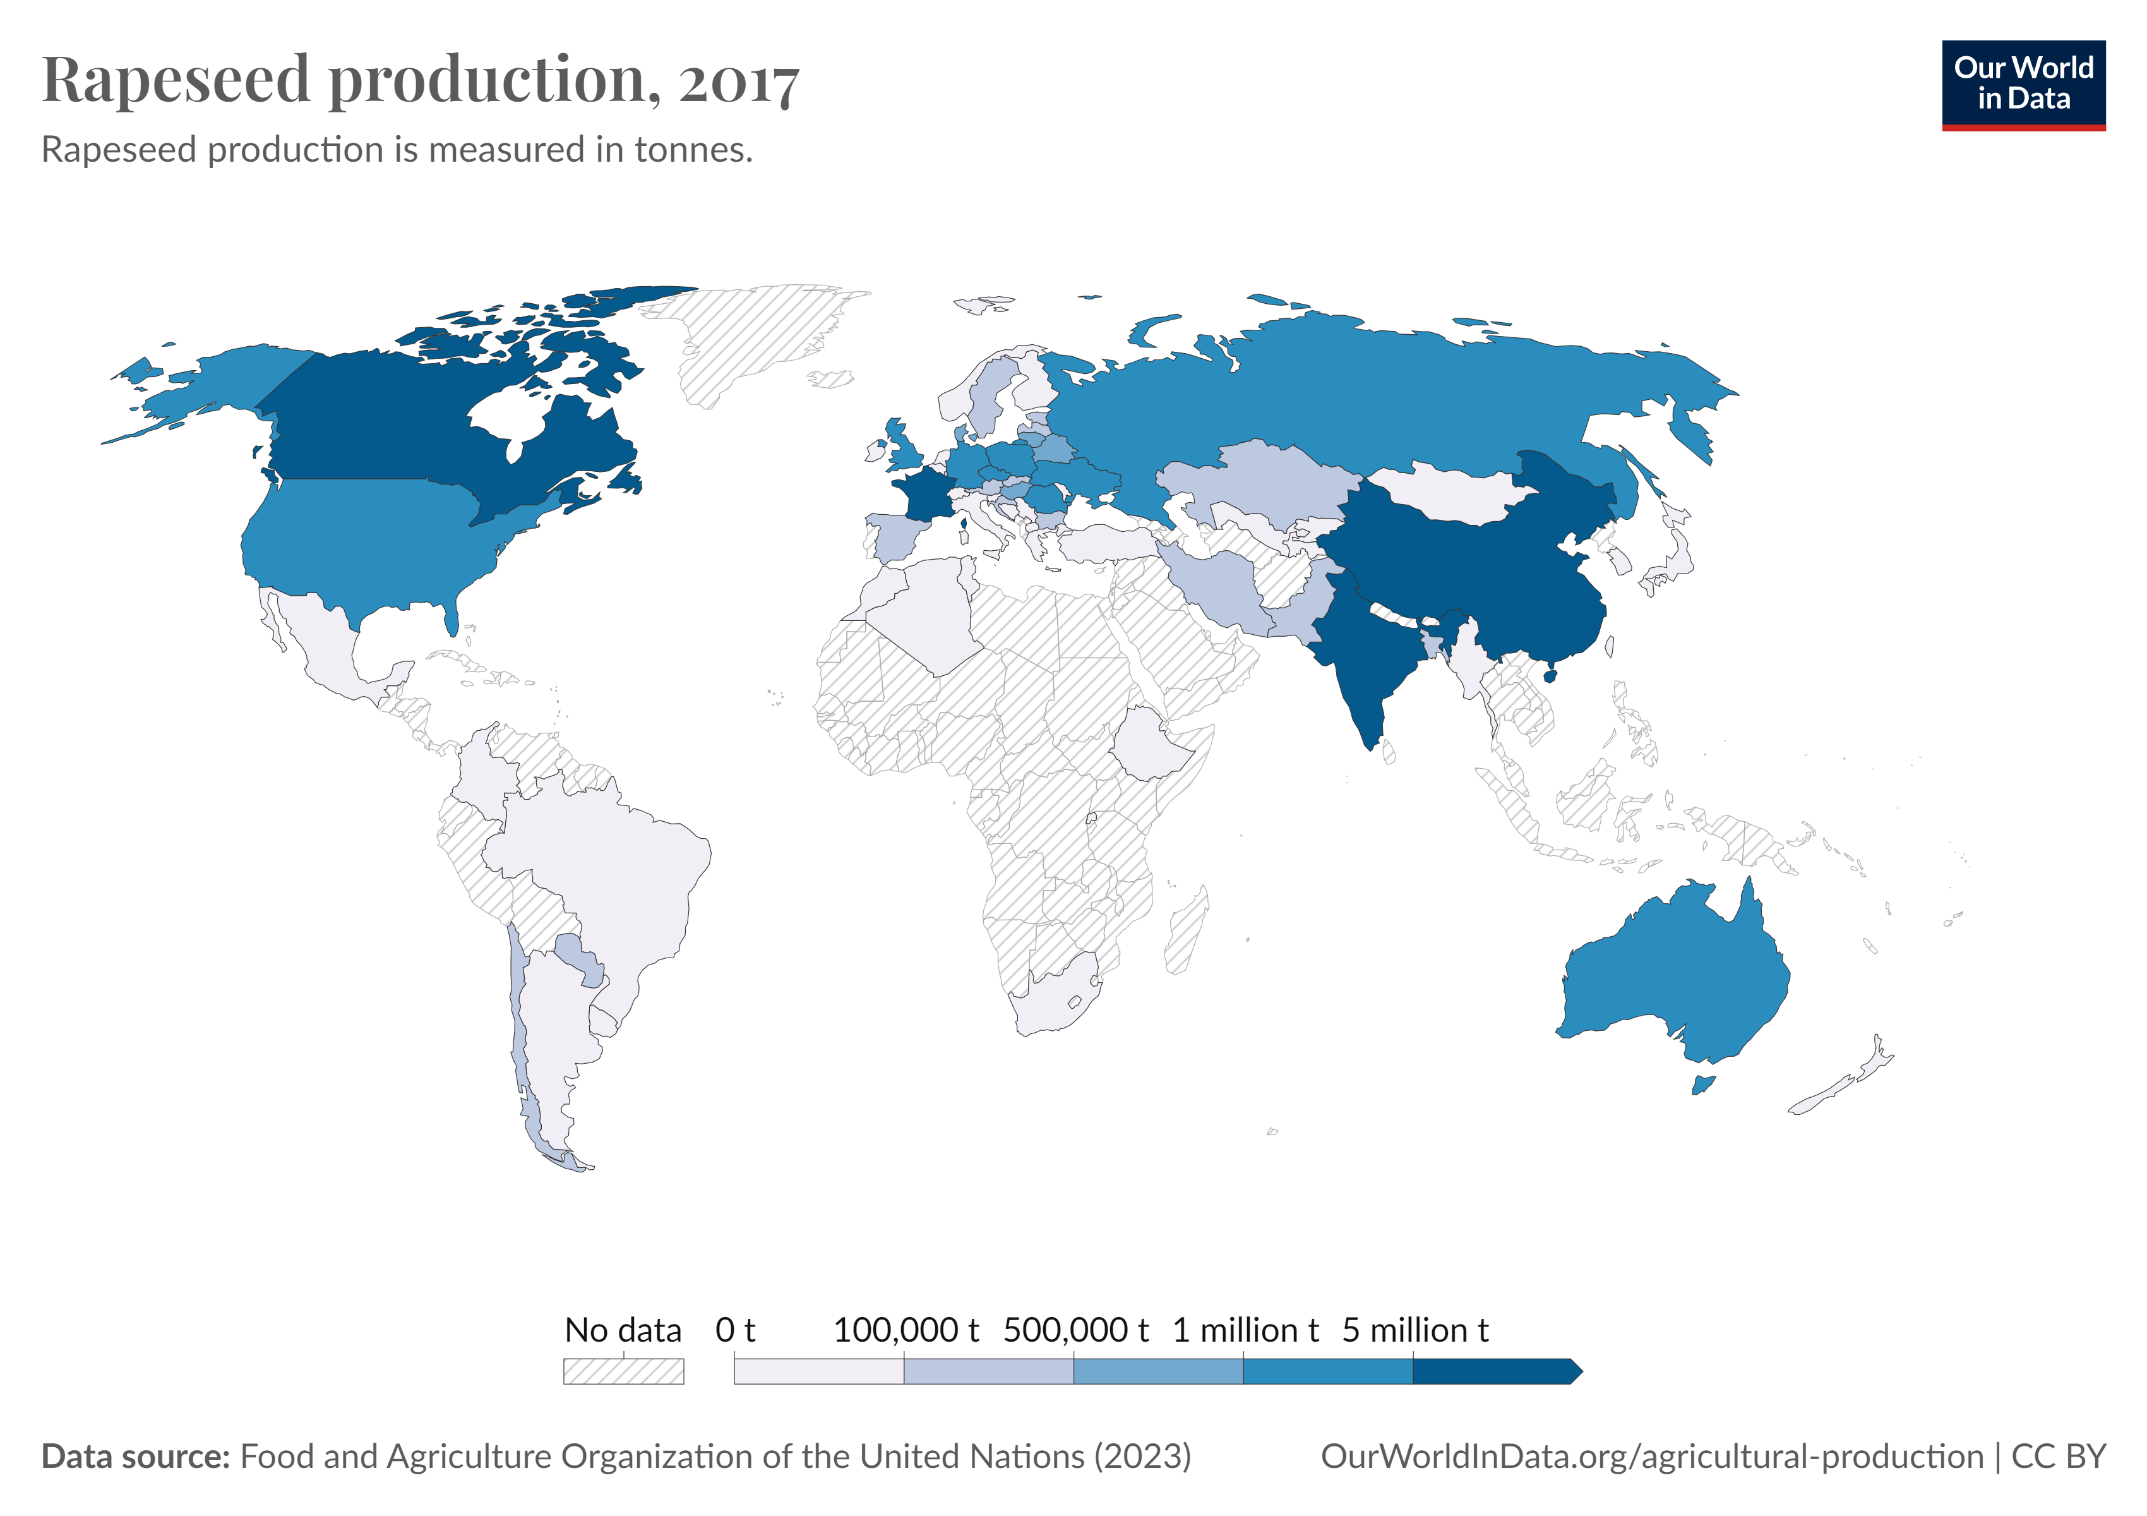
Comparison between India and foreign countries
The largest producer of Cereals and Rapeseed are India, China, America, Russia, Australia and some parts of Europe.

Slide 12
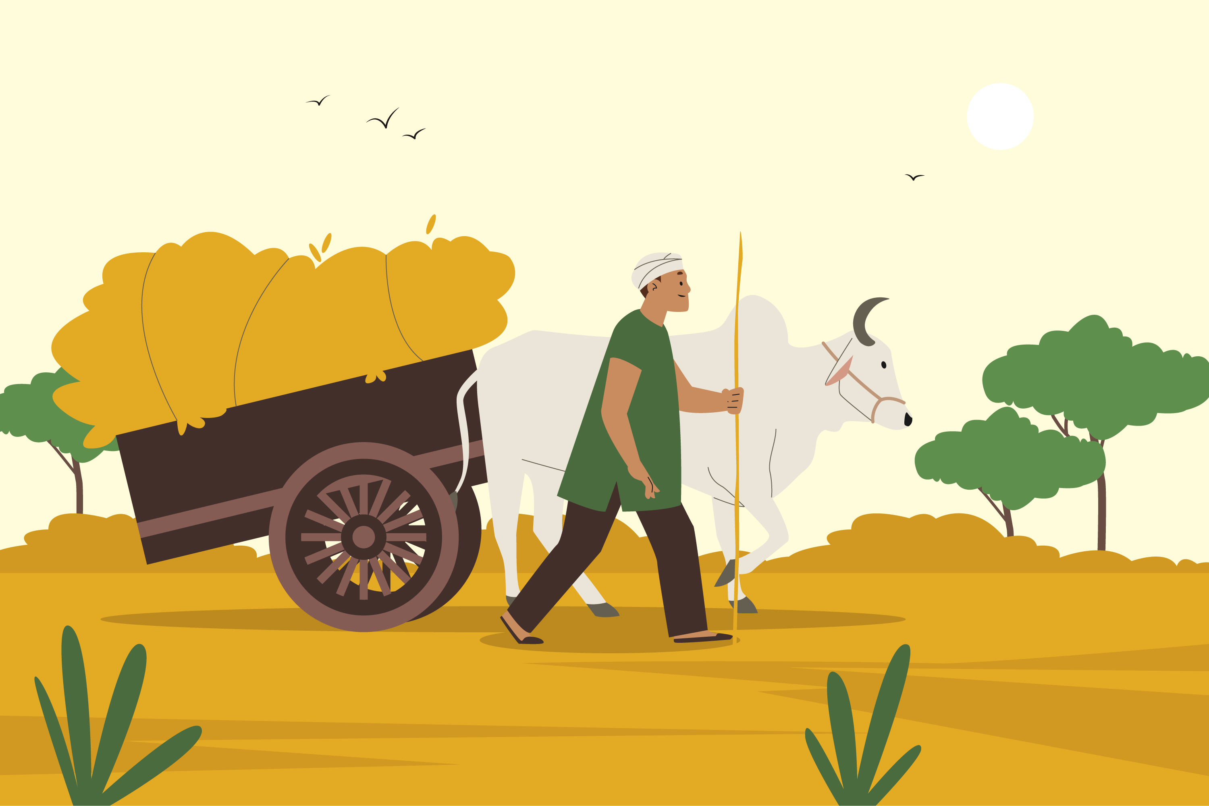
Summary
India is a large producer of several agricultural products. In terms of quantity of production, India is the top producer in the world in milk, and second largest in wheat and rice. Agricultural production is prone to several risks which affect both producers and consumers. In order to enhance investment and achieve a sustained increase in production, long-term strategies and policies are required to reduce risk aversion and build flexibility among Indian rural producers

Slide 13
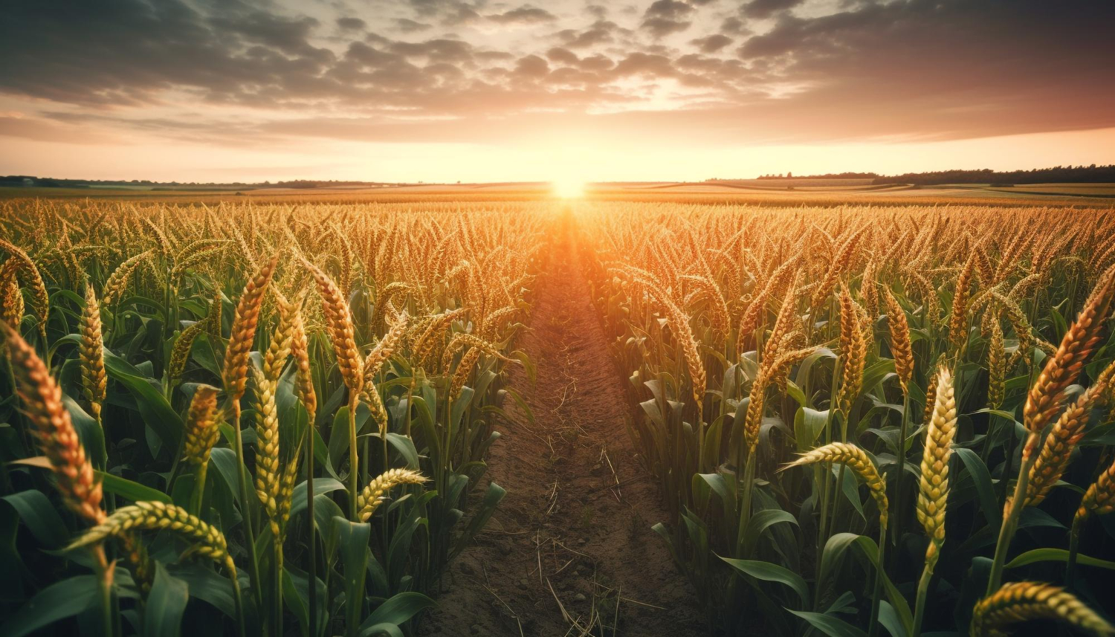
Thank you
SOHAN GURAV

